Slide 1
Updated 2 pm 1 November
Iteration 1
Draft Proposal
Set up GitHub
Gather requirements
Prototype
Iteration 3
Clients (Patient) Update records
User Login/ Logout Account Management
Services Create services & price list View list Update prices Delete records
Iteration 5
Doctors Create records View records Update records Delete records
Rules Customisation of rules for notifications
Revamp UI Improve UI Graphic representation of analysis results
Iteration 7
Template Upload email template Upload Letter of Guarantee/US Embassy Summary Screening Reminder
Email Notification Send email based on rules created Export PDF/ Word
SMS Notification Send appointment reminder to patients
Iteration 9
Fields Customisation Allow users to customise fields for forms
Search function Search for specific information in the entire application
Iteration 11
Create additional modules/ tabs Allow users to shift/ create new tabs
Currency Conversion Conversion of currency for invoice Link to Fixer.io
Iteration 13
Improve UI Bug Fixing
Preparation for Final
User Testing 1
28 Oct
User Testing 2
3 Feb
User Testing 3
17 Mar
1
2
3
4
5
6
7
8
9
10
11
12
13
14
15
4 Oct
18 Oct
1 Nov
15 Nov
29 Nov
13 Dec
27 Dec
10 Jan
24 Jan
7 Feb
21 Feb
6 Mar
20 Mar
3 Apr
17 Apr
Proposal Submission
17 Oct
Acceptance
4 Nov
Go Live
15 Feb
Midterm
20 Feb
Poster
27 Mar
Final
10 Apr
Iteration 2
Analysis KPI of different teams Ranking (Doctor, Specialty, Referral) Gender and Age Report
Timeline Cradle to grave timeline Add/ Edit/ Delete Screenings Group patients for recommended screenings based on age
Clients (Patients) Create records View records Delete records
Preparation for Acceptance
Iteration 4
Exam Period
Iteration 6
Tasks Create tasks View tasks (dashboard)
Case CRUD Consultation CRUD Medical CRUD Admission CRUD Letter Of Guarantee
Revamp UI
Iteration 8
Invoices Generate invoice Export in PDF/ Excel Track deleted records
Report Generate reports (summary of price/ services/ admission) Filter function (patient, task, period)
Iteration 10
Migration of data from client’s current system
Preparation UT 2 and Midterm
Iteration 12
Improve UI Bug Fixing
Preparation for Final
Iteration 14
Preparation for Final
Legend:
Milestones
Core
User Testing
Secondary
Non-coding tasks
Tertiary
2 weeks iteration
Good-to-have

Slide 2
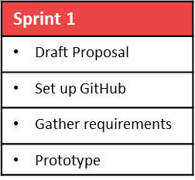
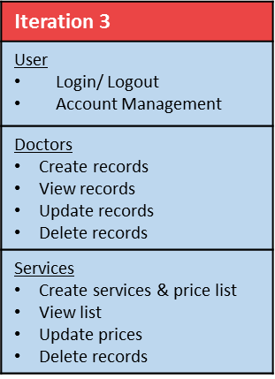
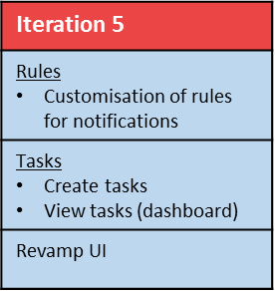
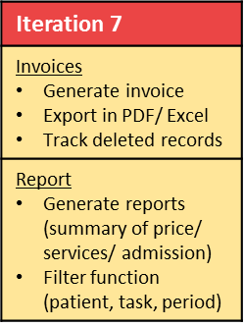
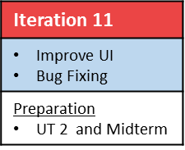
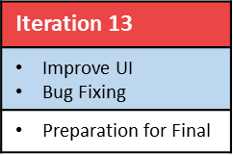
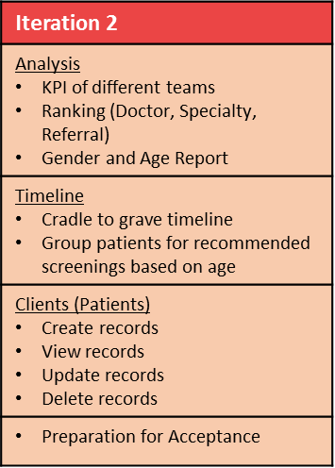

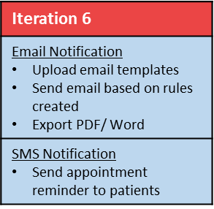
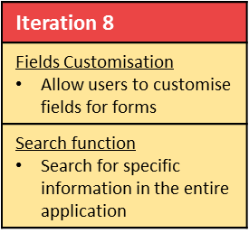
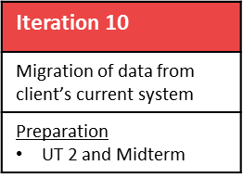
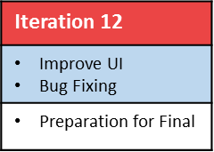
User Testing 1
28 Oct
User Testing 2
10 Feb
User Testing 3
17 Mar
1
2
3
4
5
6
7
8
9
10
11
12
13
14
15
4 Oct
18 Oct
1 Nov
15 Nov
29 Nov
13 Dec
27 Dec
10 Jan
24 Jan
7 Feb
21 Feb
6 Mar
20 Mar
3 Apr
17 Apr
Proposal Submission
17 Oct
Acceptance
4 Nov
Go Live
15 Feb
Midterm
20 Feb
Poster
27 Mar
Final
10 Apr
Legend:
Milestones
Core
User Testing
Secondary
Non-coding tasks
Tertiary
2 weeks iteration
Good-to-have

